Slide 1
Abstract Writing Workshop
February 8th 2024
Samantha Doonan
Michael Green

Slide 2
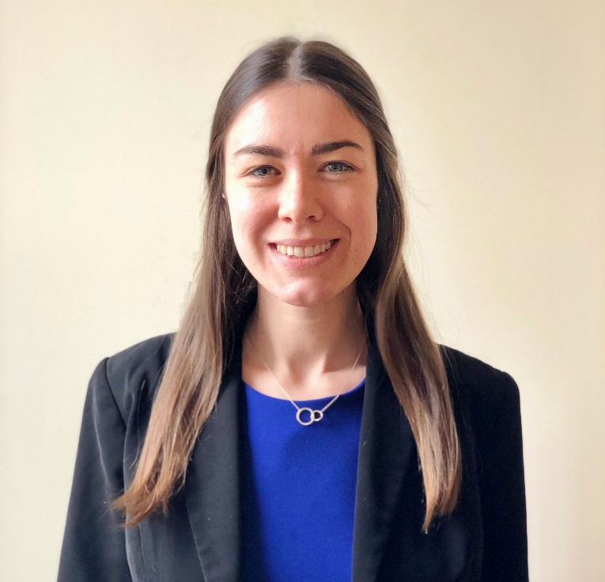
Who we Are
Samantha Doonan
Michael Green
Learning about the IAPHS Student Committee here: https://iaphs.org/iaphs-student-committee/

Slide 3
Objectives
Describe what a conference abstract is
Explain types of abstracts
Review different abstract structures
Examine how to construct an abstract and view examples
Share resources and address questions

Slide 4
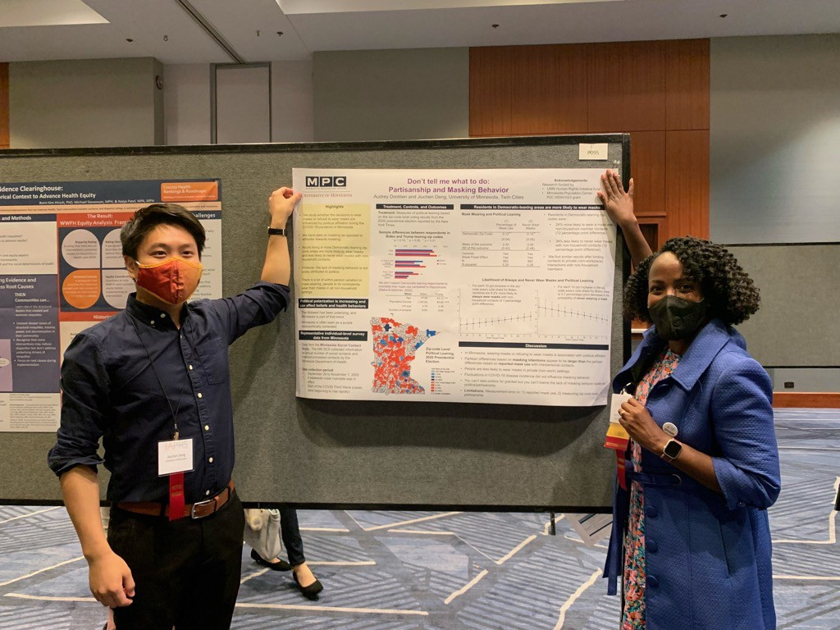
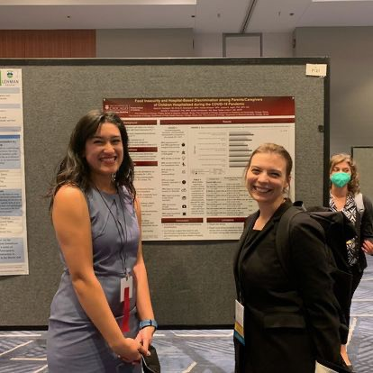
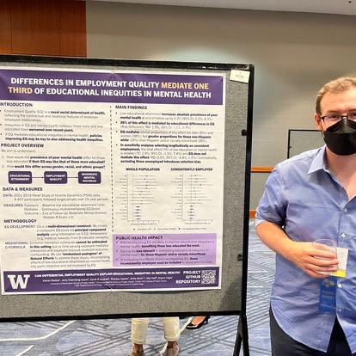
Conference Abstracts
A concise statement of the major elements of your work (e.g., research, evaluation, project)
Often a condensed version of a full scientific paper and main results
Typically aligns with conference theme
Guidelines
Requirements for abstracts/ proposal

Slide 5
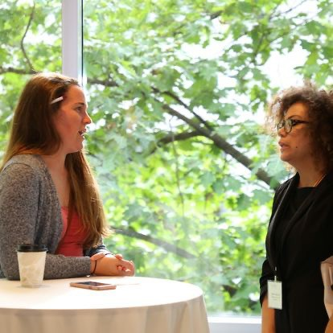
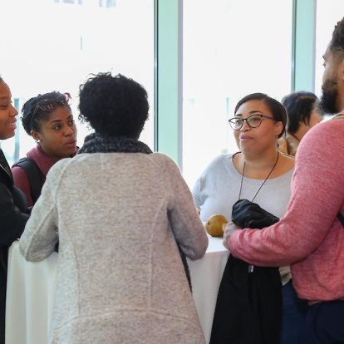
Why submit an abstract?
Presentation medium is often more personal & relax
Boost professional skills
Multiple points of feedback
Network with others in your area of interest
Promote your work/before entering the job market
Help build your professional brand/identity

Slide 6
Descriptive abstracts
Indicates the type of information found in the work
Makes very little judgments about the work; nor does it summarize any results or conclusions
Incorporates keywords found in the text and may include the purpose, methods, and scope of the research
For example, Akilah presented these two abstracts (not at IAPHS):
The creation of a diabetes & mental health guide for St. Louis CHW
Sleep Health Literacy Study: The stepped-wedge cluster RCT design

Slide 7
Informative abstracts
Presents and explains all the main arguments
Reports the important results and evidence in the complete work
Includes the information that can be found in a descriptive abstract (purpose, methods, scope) AND also includes the results and conclusions of the research
The length varies according to discipline and conference requirements

Slide 8
Writing the abstract

Slide 9
Structure and language
Use consistent constructions (e.g., if you mention that the project examines Blue, Red, and Yellow, then mention these in the same order all the time)
Structure your abstract so that the flow is organized and clear
Generally, move from broad to specific in the background section
Write only one thought per sentence
Be careful with jargon use, consider your audience

Slide 10
The Five C. s …
Concise – no excess wordiness or unnecessary information
Complete – covers the major parts of the project, study, or analysis
Clear – readable, well organized, and avoids heavy jargon use*
Cohesive – flows smoothly between the parts
Consider – the audience, review panels, conference attendees

Slide 11
Abstracts can have various structures. Always review the submission form and consider what you want to your potential audience to know.
Introduction | Purpose | Background | Background | Issue
Methods | Objectives | Methods | Methods | Description
Results | Materials & Methods | Results | Results | Lessons Learned
Conclusion | Results Conclusion | Implications | Findings Conclusions | Recommendation
Significance | Objective | Importance | Objective | Background
Aim | Design | Objective | Design | Methods
Methods | Participants | Methods | Sample | Preliminary Results
Results | Results | Results | Findings | Next Steps
Conclusion & | Conclusion | Conclusion & | Conclusion
Implications |  | Relevance | Implications

Slide 12
Writing the Title
The title needs to capture attention. It may be your only chance to explain why your problem matters.
The purpose of the title is to draw people into your session or to your poster - be bold without being controversial.
Include your approach, method, and/or data source if possible.
Less than 15 words
Use key words from the conference call or theme of the session.

Slide 13
Examples
“We’re more likely to fund armed guards than school counselors”: A qualitative exploration of how school-based policies and practices impact mental health service access for sexual and gender minority youth.
Maternal weight, perceptions of care, and satisfaction with the childbirth experience.
Assessing the content and effectiveness of state laws addressing adolescent intimate partner violence in schools.

Slide 14
Writing the Background
Assume the reader does not know about your interest area
Deliver only as much information as is needed to understand why you did the project/work
Provide the context or explanation for doing the study
Does not include a full literature review or the whole history
Explain why your abstract is important or novel
Why did you do the study?
What information was lacking that prompted the study?

Slide 15
Which example is stronger?
1
Title: Sexual risk among MSM
Background: Research will be presented on MSM to determine if behaviors changed recently while syphilis increased among MSM
2
Title: Prevalence of risky behaviors and temporal trends among a national probability sample of men who have sex with men in the UK
Background: Research in the UK has found that samples from community venues and clinics overestimated sexual risk among all MSM compared to population-based samples. There is little data on sexual risk among MSM in the UK from population- based surveys and no data on temporal trends in sexual risk. We examined nationally representative data on MSM to determine if behaviors changed recently while syphilis increased among MSM.
Obscure title
No information about what is already known, or not known
No information provided on
previous studies, settings, or location
Background ends with the objective/aims of the study
16

Slide 16
Writing the Method
Write in the order that sequentially follows what was done
Analytic sample or participants
Be specific of who was included in the study
Include eligibility criteria and how they were recruited or data source
Relevant sociodemographic details (e.g., gender, martial status)
Analytical approach
Data obtained, collected, and analyzed
Include statistical measures, outcomes, and statical tests for data quantitative analysis
Include coding/synthesis approach for qualitative studies
17

Slide 17
Which example is stronger?
1
Method: An intervention was delivered and evaluated. One intervention component sought to improve students’ awareness and utilization of condom availability programs (CAPS) in schools by working with key school personnel, particularly nurses, to more effectively implement district CAP policies. Six intervention and six control high schools participated in the study. Analyses included survey data from high school males.
2
Method: A multi-level intervention was delivered and evaluated across five years (2006-2011) in a large public school district in Los Angeles, California. One intervention component sought to improve students’ awareness and utilization of condom availability programs (CAPs) in schools by working with key school personnel, particularly nurses, to more effectively implement district CAP policies. Six intervention and six control high schools participated in the study. A total of 15,936 students were eligible for the study. Final analyses included survey data from 13,733 high school males across five years (T1 – T5). A mixed model logistic regression analysis was used to test for an intervention effect on males’ reports of services sought from the school nurse. Random effects on the student level were included to control for repeated measures on the same student.
18
Missing
Date/ time frame
Geographic location
Sample description
Description of the statistical analyses used

Slide 18
Writing the Results
Report the main findings with data
The intervention group was more likely than the control to use condoms
The intervention group was more likely than the control to use condoms (45% vs. 30%, p<0.01)
Describe how your results pertain to your study aim or hypothesis
Statements such as a “to be completed” or “ to be presented” are not usually acceptable (unless conference calls for in progress work)
19

Slide 19
Which example is stronger?
Missing
Descriptive summary of sample
1 2
Results: Participants were ethnically diverse (65% non-white) and 85% (n=17) reported UAI with concurrent binge drinking during the past 3 months. Analysis of in-depth interviews specifically with those engaging in UAI and binge drinking, revealed that men 1) face challenges navigating community normative drinking expectations, such as peer pressure to drink and “hook up” with sexual partners, 2) believe that binge drinking and episodic substance use enhance experiences of disinhibition, euphoria, and spontaneous sexual behavior, and 3) express a desire for intimacy and ability to trust anonymous partners, relying on partner-focused responsibility (an assumption that partners will disclose if HIV-positive or use a condom to protect the participant)
Results: Participants were ethnically diverse and reported UAI with concurrent binge drinking. Analysis of in-depth interviews specifically with those engaging in UAI and binge drinking, revealed that men 1) face challenges navigating community normative drinking expectations, such as peer pressure to drink and “hook up” with sexual partners, 2) believe that binge drinking and episodic substance use enhance experiences of disinhibition, euphoria, and spontaneous sexual behavior, and 3) express a desire for intimacy and ability to trust anonymous partners, relying on partner- focused responsibility (an assumption that partners will disclose if HIV-positive or use a condom to protect the participant).
20

Slide 20
Writing the Conclusion
Refer and use the same language mentioned in the introduction/background
Statements is supported by the text in the body section (e.g., results, lessons learned)
Need for further analysis or work in this area
Add to the literature or address a gap by…
May have room to add discussion point(s)
Limitations
Larger next steps for the study/project

Slide 21
Which example is stronger?
First statement. The risk of a woman dying as a result of pregnancy or childbirth during her lifetime is about one in six in the poorest parts of the world compared with about one in 30 000 in Northern Europe.
2
Conclusion: Local variation can be important, with unsafe abortion carrying huge risk in some populations, and HIV/AIDS becoming a leading cause of death where HIV-related mortality rates are high.
Inequalities in the risk of maternal death exist everywhere.
1
Conclusion: Targeting of interventions to the most vulnerable—rural populations and poor people—is essential if substantial progress is to be achieved.

Slide 22
Any Questions?

Slide 23
IAPHS 2024 Call for Abstract is Open!
Theme: “Tackling declining life expectancy in the US: investigating social drivers and policy solutions”
St. Louis, Missouri
Submission Deadline: March 10, 2024
Word Count: 2000 character limit (including spaces)
Learning about the conference here:
https://iaphs.org/conference/

Slide 24
Submission Policy
Abstracts submitted for poster sessions or oral presentations
May be submitted: May not be submitted
:
Abstracts of work that has been neither published nor presented at another
meeting.
Abstracts derived from papers under review by a journal but not yet accepted.
Abstracts that have been submitted to other meetings for presentation and are under
review (however, if accepted may not be presented both at IAPHS and another meeting).
Abstracts derived from papers that have already been published, either in print or in an online format
Abstracts based entirely on research that has
been presented at other meetings, even if unpublished.

Slide 25
Submission Guidelines and Criteria for Review
Submissions must focus on population health, broadly defined.
Submissions should not include unnecessary disciplinary jargon. Remember that there is a strong likelihood that your submission will be reviewed from at least one person outside of your field. If the reviewers do not understand your submission, it is less likely to be selected.
If your panel submission or abstract is based on original research, you must include
enough details about your data and/or results to convince the Program Committee that your work will be ready for presentation at the October meeting.
Priority will be given to submissions that will appeal to an interdisciplinary audience

Slide 26
Resources
NC State University: Department of History – Tips for Writing Conference Paper Abstracts
Duke University: Getting Published – Posters & Visual & Video Abstract
George Mason University: The Lab Writing Center and Communication – Writing an Abstract
The Geek Anthropologist – So You’re Giving a Conference Presentation
University of North Carolina at Chapel Hill: The Writing Center – Conference Papers
Northwestern: The Writing Center – Checklist for Conference Presenters
UC Davis: Undergraduate Research Center (includes video) – How to Write an
Abstract for the Undergardate Research, Scholarship, and Creative Activities Conference
Notes:
https://iaphs.org/abstract-search/

